Slide 1
Sorting Algorithms Benchmark
By: ASIA ASSI & RAND HUSSEIN
DR.AHMAD FAHEL

Slide 2
Algorithms Used
✓ Insertion Sort
✓ Merge Sort
✓ Heap Sort
✓ Quick Sort
✓ Randomized QuickSort

Slide 3
Dataset Types
Random Data
Sorted Data
Reverse Sorted Data
Few Unique Values

Slide 4
Dataset Sizes
1000 elements
10,000 elements
50,000 elements
100,000 elements

Slide 5
Benchmark Measurement
Each algorithm receives the SAME input data.
Execution time measured using System.currentTimeMillis().
Time recorded in milliseconds (ms).
Results exported and plotted in charts.

Slide 6
Key observations and comparisons
Merge Sort and Heap Sort are the most stable algorithms, unaffected by dataset order.
QuickSort fails on Sorted, Reverse, and FewUnique inputs, confirming textbook worst-case behavior..
Randomized QuickSort is significantly faster and safer, preventing stack overflow and avoiding worst-case time.
Insertion Sort becomes impractical for large datasets, except when input is almost sorted
FewUnique data causes extremely bad QuickSort partitions, explaining crashes and O(n²) behavior.

Slide 7
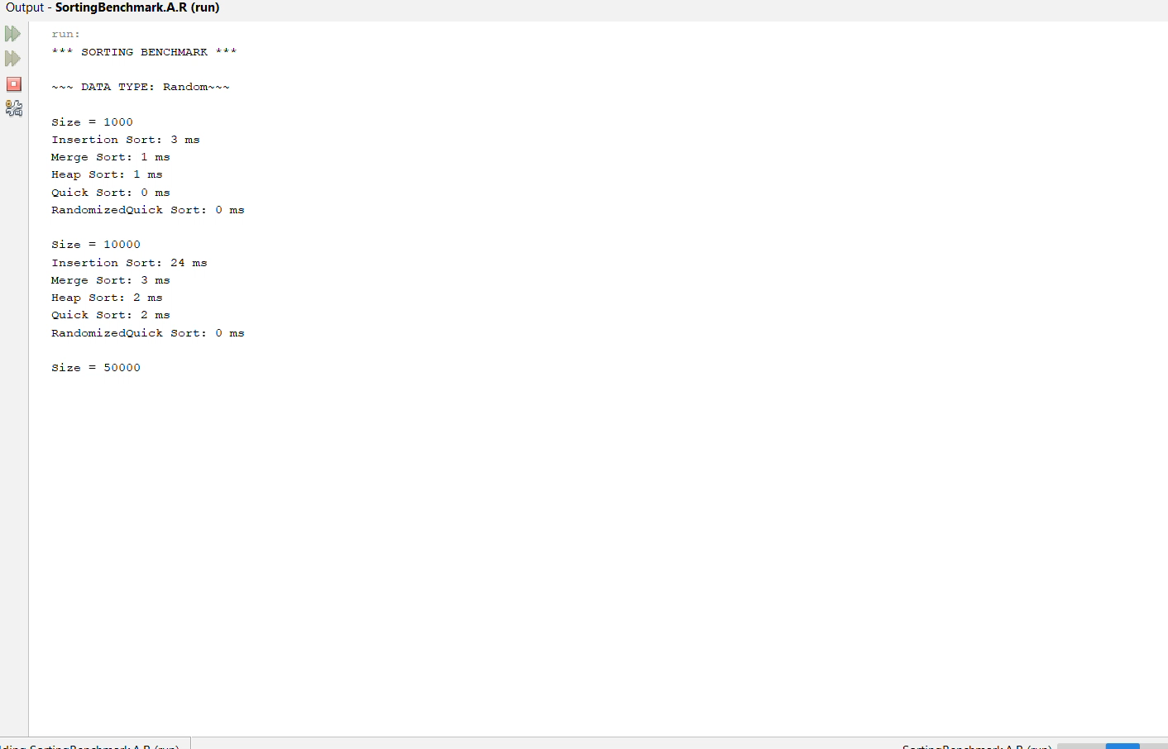
A short demo of our dashboard

